Slide 1
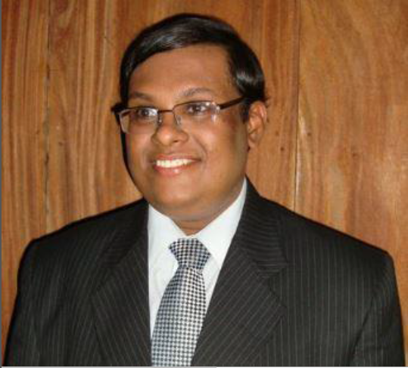

SE3070
Case Studies in Software Engineering
Lecture 01
Introduction
Mr.Udara Samaratunge
Faculty of Computing
Department of CSSE

Slide 2
Lecturer Details
SE3070
Udara Samaratunge(LIC)
Lecturer – Department of Computer Science & Software Engineering Faculty of Computing Udara.s@sliit.lk
Ms.Dilani Lunigalage
Lecturer – Department of Computer Science & Software Engineering Faculty of Computing
Dilani.l@sliit.lk
Mr. Lasitha Petthawadu (Visiting Lecturer)
Software Architect at Limark Technologies
** Enrollment Key - SE3070

Slide 3
Learning Outcomes
SE3070
LO1: Develop a software design solution to a given
case study.
LO2: Apply appropriate Object-Oriented design
patterns for the proposed solution.
LO3: Implement the case study for the proposed
design.
LO4: Demonstrate the ability to apply appropriate
coding standards and best practices in
implementing the solution.
LO5: Examine the performance bottlenecks in a given
system using profiling techniques to optimize
performance.

Slide 4
Assessment Criteria
SE3070
CA Component (70%)
Design walkthrough
Implementation walkthrough
Practical Test
20% LO1, LO2
30% LO3, LO4
20% LO5
Final Examination 30% LO1-LO5
To pass this module, students need to obtain a pass mark in both “Continuous Assessments” and “End of the Semester Examination” components which would result in an overall mark that would qualify for a “C” grade or above.

Slide 5
Assessments
SE3070
Four Members should be in 1 group.
Design Walkthrough – Design Presentation (Group work)
Implementation Walkthrough – Demonstration (Group work)
Lab Test – In-class submission (Group work)

Slide 6
SE3070
Assessment Delivery
Assignment | Content | Submission (Tentative)
Design walkthrough | Propose Design for a given case study – In class presentation | Week 4 & 5
Practical Test | Performance tuning – Lab test | Week 10
Implementation Walkthrough | Final implementation of the proposed design - Walkthrough | Week 12 & 13

Slide 7
Recommended Texts
SE3070
I. Sommerville, Software engineering, 10th ed.
Pearson Education, 2016.
E. Freeman, E. Robson, B. Bates and K. Sierra, Head first design patterns, 2nd ed. India: O'Reilly, 2014.
N. E. Fenton, S. L. Pfleeger , Software Metrics: A
Rigorous and Practical Approach, 2nd ed.

Slide 8
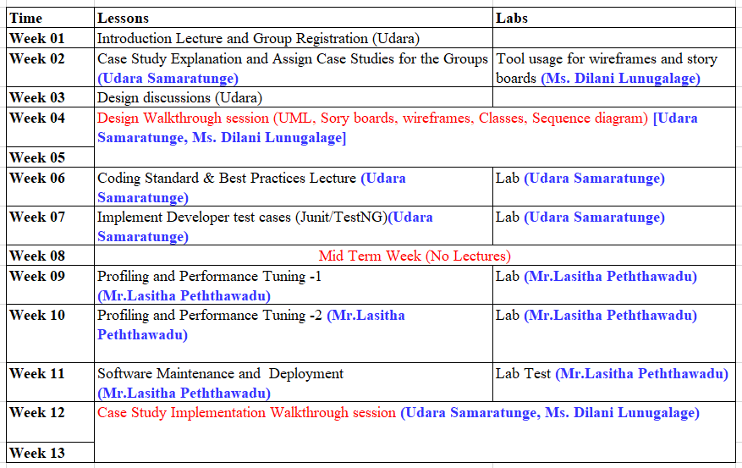
CSSE Delivery Plan
SE3070
10
SLIIT - Faculty of Computing

Slide 9
Information on
Conducting Assessments

Slide 10
How it is going to work…..
Work in groups of 4.
Register through Courseweb link.
Can discuss the progress during lab sessions.
½ of the groups will be asked to work on a Public Transport Ticketing System.
The rest of the groups will be asked to work on Procurement System for construction industry.

Slide 11
Case studies design & implementation
Student Group No | Case Study – Design Walkthrough | Case Study – Implementation walkthrough
Group 01 | Case Study 01 | Case Study 02
Group 02 | Case Study 02 | Case Study 01
Group 03 | Case Study 01 | Case Study 02
Group 04 | Case Study 02 | Case Study 01
… | … | …
Group n | Case Study 01 or 02 | Case Study 02 or 01

Slide 12
SE3070
Case Studies in Software Engineering
Lecture 01 – Part II
User Centered Design
Mr.Udara Samaratunge
Faculty of Computing
Department of CSSE

Slide 13
What sort of design
A functional design
Use Case diagram identifying a high level overview
Class diagram identifying key classes & relationships
Sequences covering important use cases
An interaction design
Design concepts (high level) & storyboards (detailed UI design) or wireframes

Slide 14

Design
Systems should :
be easy to use
do useful things
enhance the lives of the people that use them
So: Design for people, not for technology.
The aim of design is to create good user experience.

Slide 15
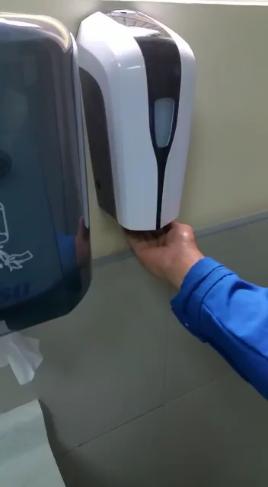
Eg: Not a good User Experience

Slide 16
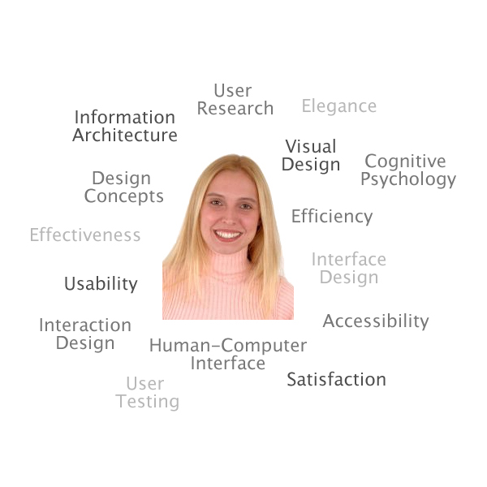
What is User-Centered Design (UCD)?
The user is put in the center of the design.

Slide 17
Why UCD/UX?
Increased customer satisfaction
Increased user productivity/efficiency/accuracy
Increased service/site usage and adoption
Decreased support and training costs
Reduced development time and costs
Create only the features users need
Reduced maintenance costs
Do it right the first time

Slide 18
Tools and Methods
Personas
Scenarios
Storyboards
Wireframes
Prototypes
Notes:
Artefacts for UCD

Slide 19
Tools and Methods
Personas
Scenarios
Storyboards
Wireframes
Prototypes
Analysis

Slide 20
Tools and Methods
Personas
Scenarios
Storyboards
Wireframes
Prototypes
Analysis
Design

Slide 21
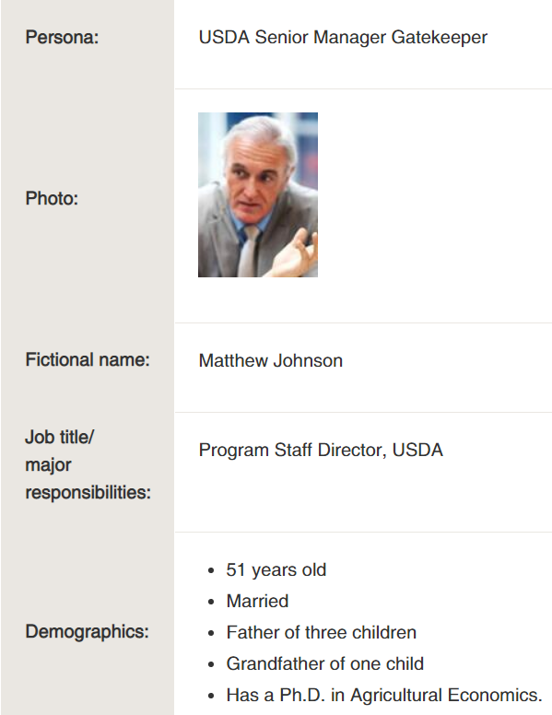
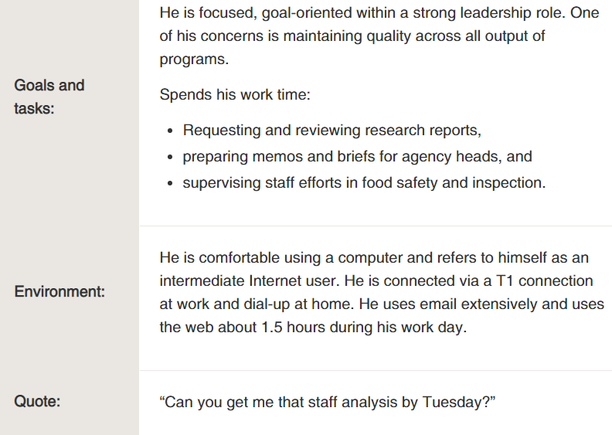
What is Persona?

Slide 22
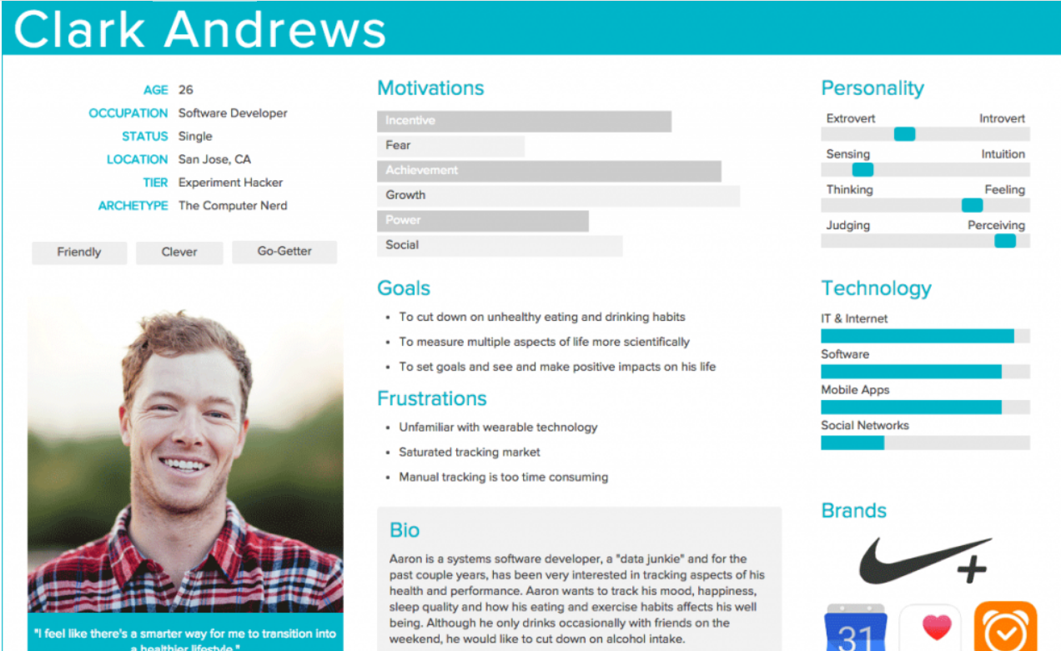
Personas

Slide 23
From Analysis to Design
We have focused so far on analyzing the problem
Who are our users?
What do they want to do and why?
Now we need to move from this contextual information to a design
The design emerges iteratively through repeated design-evaluation-redesign cycles

Slide 24
Storyboards
Narrate a situation showing how it plays out in the context of actual tasks.
Technique from film-making.
Series of frames from the user experience point of view.
Communicate the feel of the ‘flow’ of the design
Usually based on scenarios
Generally a combination of text and images.

Slide 25
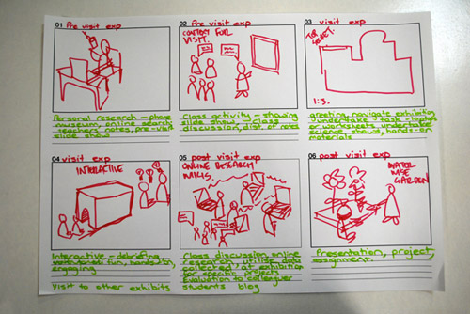
Notes:
The process of visiting an exhibition, including what happens before and after

Slide 26
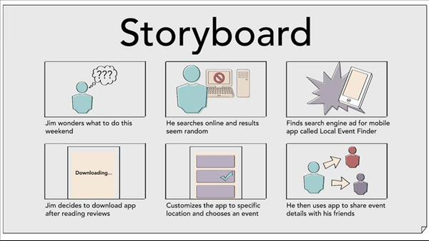
Notes:
An app for finding events in the local area

Slide 27
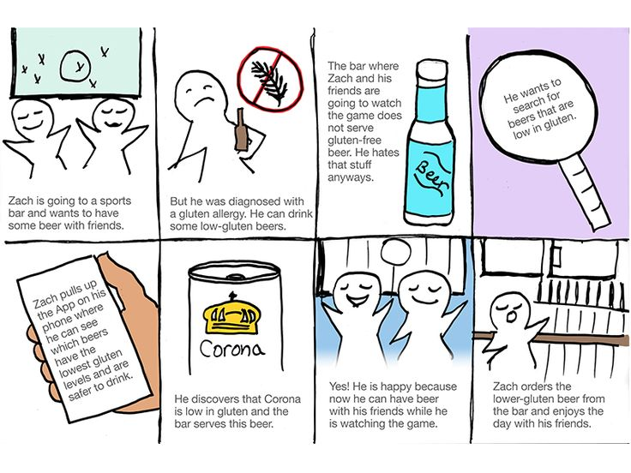

Slide 28
Example
Company called Enable Quiz offer lightweight technical quizzes. Managers use the quizzes to screen new candidates and also assess the skill sets of their existing teams so they can plan training, etc. Let’s say the persona ‘Helen the HR Manager’ wants to use the Enable Quiz service to screen a new engineering candidate.
As the HR manager, I want to create a screening quiz so that I can understand whether I want to send possible recruits to the functional manager.
Come up with a storyboard for the above scenario in the system.

Slide 29
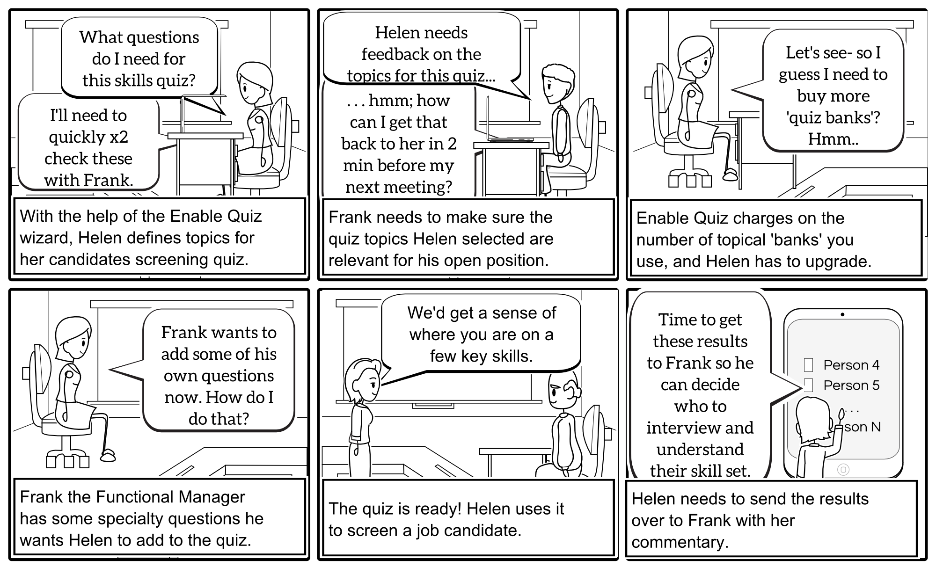
Storyboards

Slide 30
Wireframes
Range from "back-of-an-envelope" sketch to a full design.
Intended to provide an early approximation.
Show how the user will interact with the system.
Can be hand drawn or digital.

Slide 31
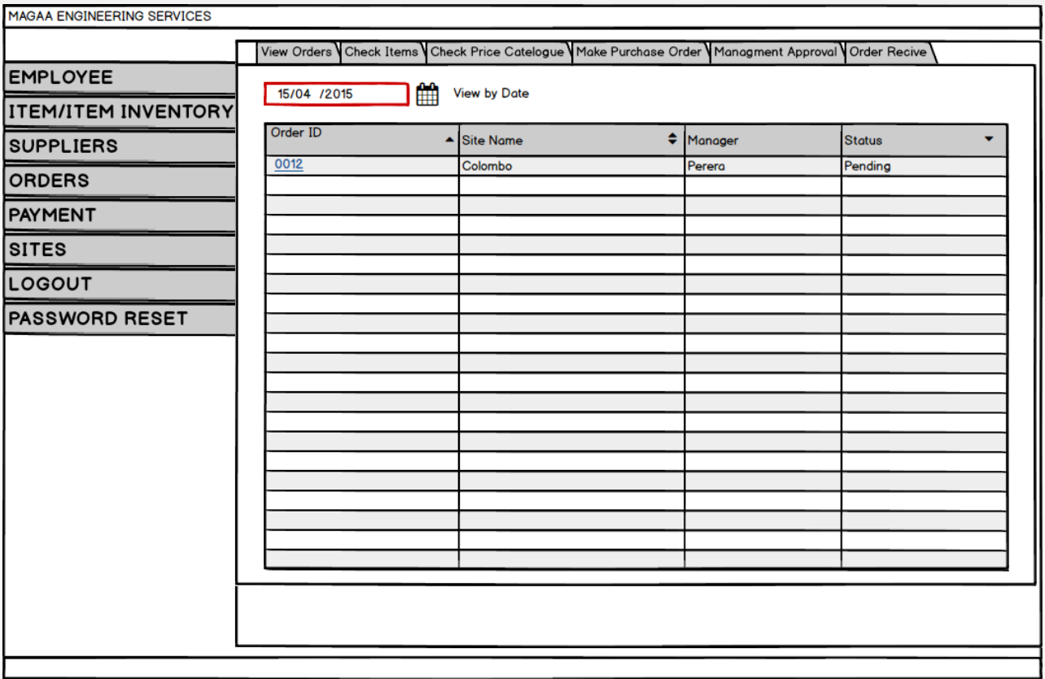
High Fidelity Wireframe Diagrams

Slide 32
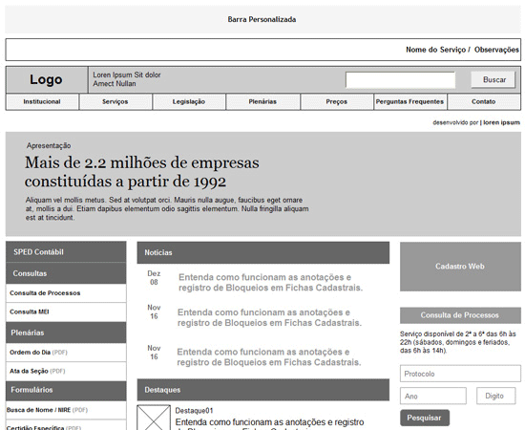

Slide 33
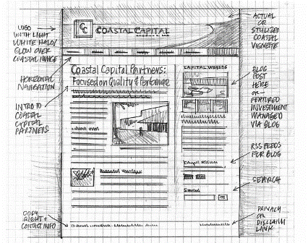
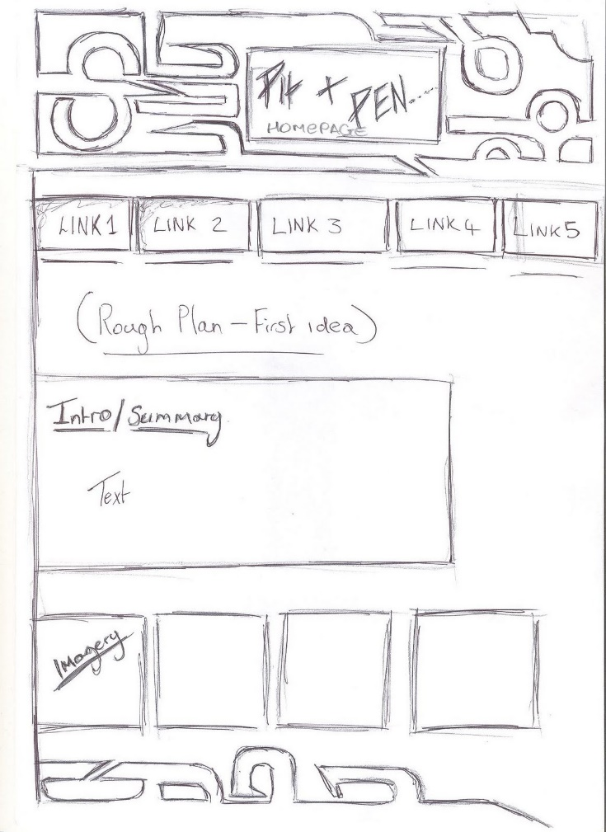
Low-Fidelity Wireframe Diagrams

Slide 34
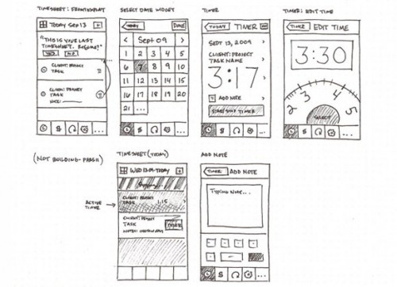
Low-Fidelity Wireframe Diagrams
Source: Anthony Armendiaz (flickr)

Slide 35
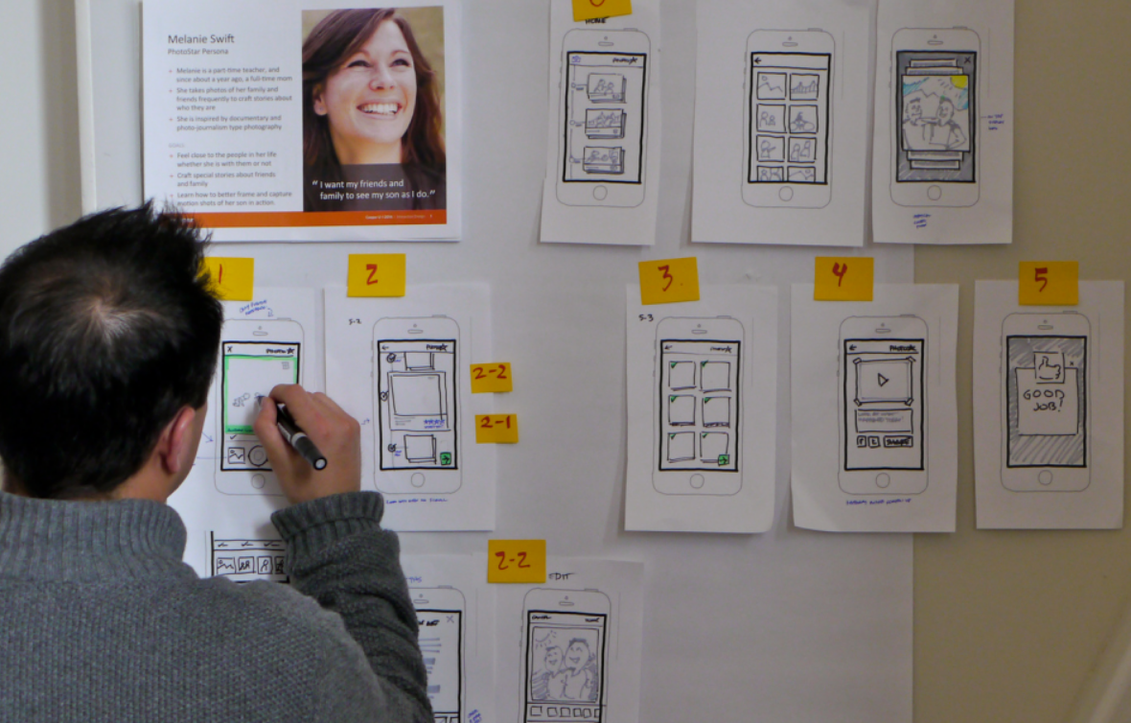
Adjust Wireframes based on the personas

Slide 36
Tools
Balsamiq Mockups
http://www.balsamiq.com/products/mockups
(Web demo free)
Mock Flow, web-based, free
http://www.mockflow.com/
Pencil, an open-source GUI prototyping tool
http://pencil.evolus.vn/

Slide 37
The End

